Slide 1
Step into a new area
Start with papers
Shan Zhang (NUS-HCI Lab)

Slide 2








Phase1: Databases/Electronic sources
Publisher-specific databases
IEEEXplore
ACM Digital library
ScienceDirect
Springer
Wiley InterScience Journal Finder
Kluwer Online (law/patent)…..
According to the previous studies, IEEE, ACM + 2 index systems (like Scopus, Inspec/Compendex) are enough
Index system:
SCOPUS
Inspec/Compendex
Google Scholar

Slide 3
Phase 2: Expand the results
Editing the search queries (Use AND OR - )
Expand the database (may not need)
Snowballing process:
Exploring the references
Suggestions from related work
Recommendations from Mendeley

Slide 4
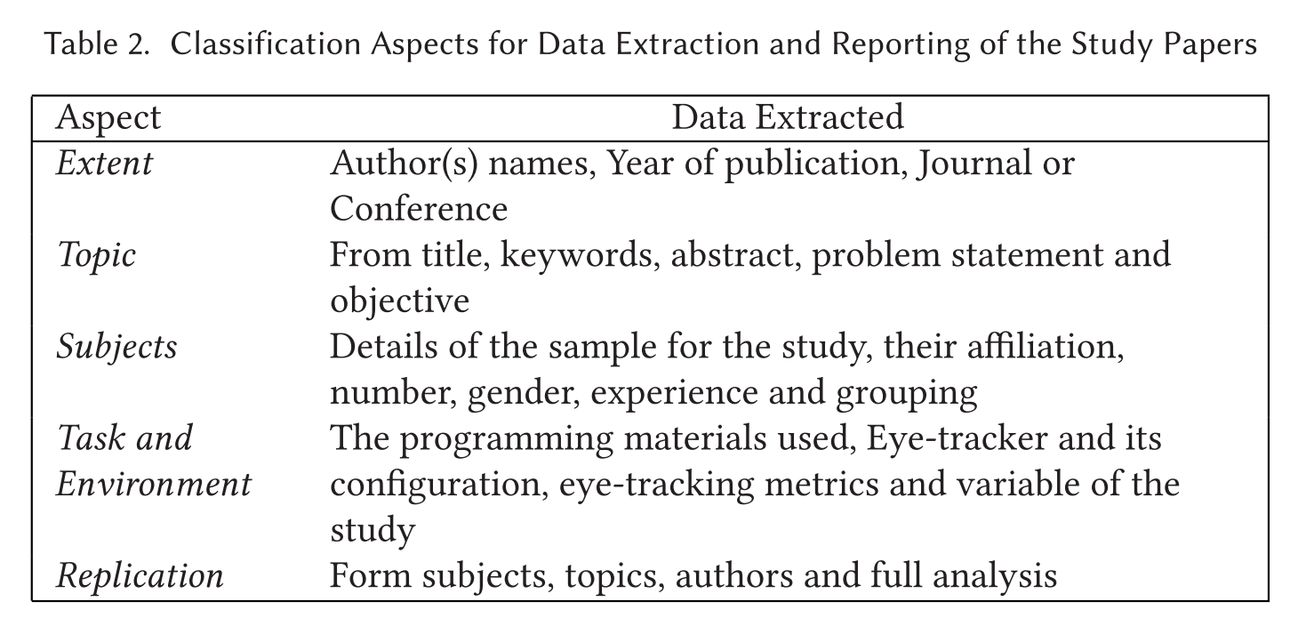
Phase3: Inclusion and Exclusion
A full analysis on the papers (an example)
*A Survey on the Usage of Eye-Tracking in Computer Programming

Slide 5
Inclusion criteria
Example1: A survey on the usage of eye-tracking in computer programming
Progressive
Use eye-tracking in programming
Published in a journal, conference… reporting the results of an experiment using eye-tracking
Not specifically on program, but related like software engineering. UML, flowcharts instead of real source code

Slide 6
Example2: Analytics for the Internet of Things: A Survey
Intersection
Were from original research
Described actual designs, implementations, and results
Applied analytics
Served LoT use-cases

Slide 7
Exclusion example:
Papers not reporting the use of eye-trackers.
Papers using eye-trackers in a context not related to computer programming.
Papers not published in English
Papers that did not go through a referring process, such as posters, work sessions, lecture notes, and dissertations.
Papers re-reporting the results, or doing a re-analysis of a previously published experiment were studied, and the most comprehensive paper was selected.
Other materials such as books, technical papers, government reports, letters and editorials, possession papers, and papers with an abstract but no full text available.
Papers not involving an empirical study or only those that propose a proof of concept

Slide 8
Paper related:
Guidelines for performing Systematic Literature Reviews in Software Engineering http://citeseerx.ist.psu.edu/viewdoc/download;jsessionid=DB7B94CC653D6D5AD7B94F5A54FF0FC9?doi=10.1.1.117.471&rep=rep1&type=pdf
Systematic Mapping Studies in Software Engineering http://www.robertfeldt.net/publications/petersen_ease08_sysmap_studies_in_se.pdf
Systematic literature reviews in software engineering – A systematic literature review
Preferred Reporting Items for Systematic Reviews and Meta-Analyses: The PRISMA Statement https://journals.plos.org/plosmedicine/article/file?id=10.1371/journal.pmed.1000097&type=printable
Five steps to conducting a systematic review https://journals.sagepub.com/doi/pdf/10.1177/014107680309600304

Slide 9
System Review:
Frame questions for a review
Identify relevant work
Assessing the quality of studies
Summarizing the evidence
Interpreting the findings
Require a lot of efforts

Slide 10
Systematic Mapping
Definition of research questions (research scope)
Conduct search for primary studies (all papers)
Screening of papers for inclusion and exclusion (relevant papers)
Keywording of abstracts
Data extraction and Mapping of studies (systematic map)
A more coarse-grained overview

